Slide 1

Extend your Azure Practice anywhere with Azure Arc

Slide 2
Agenda
Azure Arc Intro (if required)
Azure Arc for Partners
Azure Arc Partner Opportunity
Hybrid Cloud / Unified Operations solutions
Kubernetes solutions
Data services solutions
App services solutions
ML services solutions
Technical Engagement Plan
Milestones
Accountability
Cosell Engagement Plan
Milestones
Accountability
Rhythm of Business
Resources

Slide 3




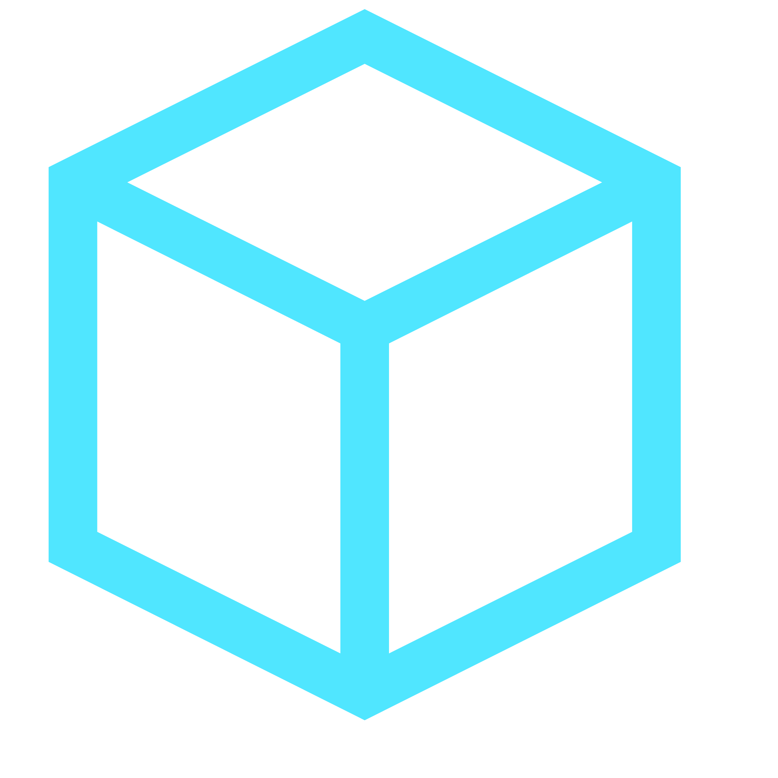


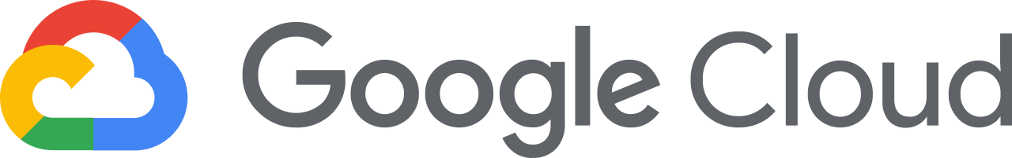









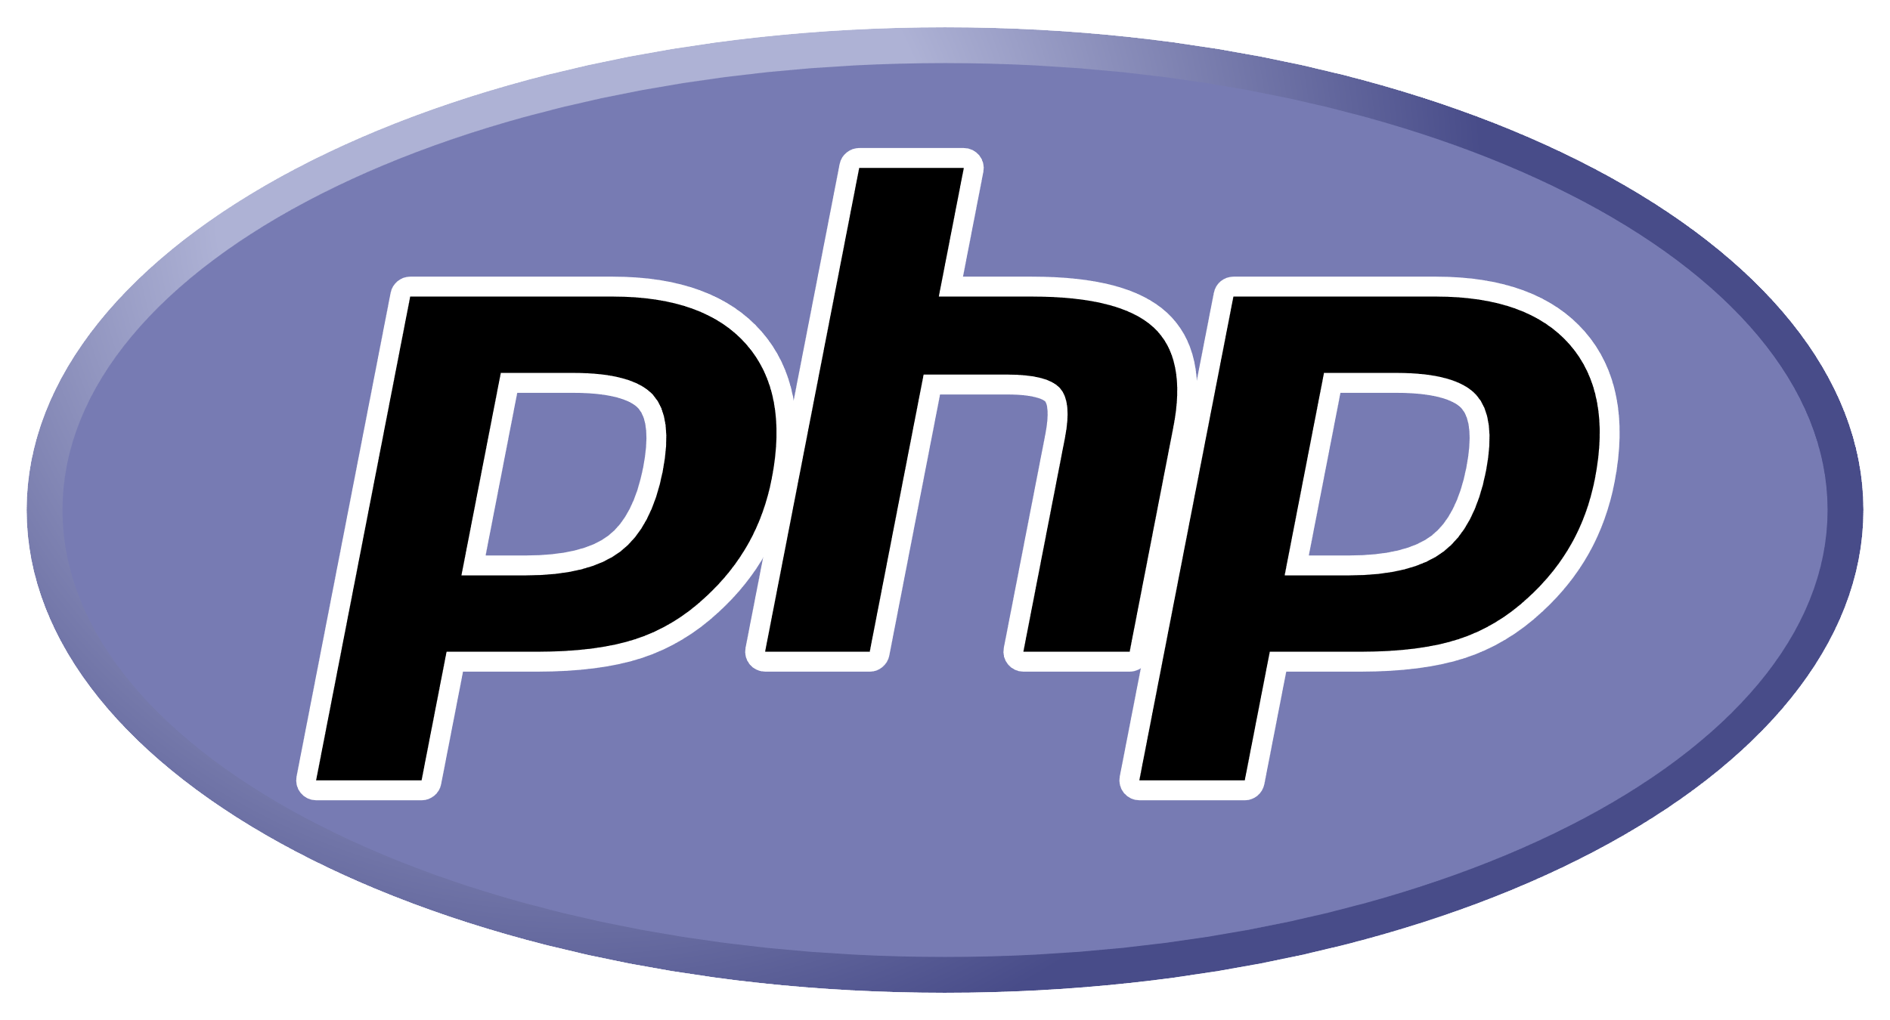


Customer environments and application requirements are evolving
Single control plane with Azure Arc
How to govern and operate across disparate environments?
How to ensure security across the entire organization?
How to best enable innovation and developer agility?
How to meet regulatory requirements and overcome technical hurdles?
100’s–1,000’s of apps
Diverse infrastructure
Hybrid & Multi-Cloud
VMs
Databases
Datacenters
Hosters
Containers
Serverless
Branch offices
OEM hardware
IoT devices
Edge
Notes:
If you look at many of our customer’s environments today, it’s clear that they continue to grow in complexity with the influx of new technologies and platform investments. I’m sure this rings true for you as well.
Applications are running across a diverse infrastructure with data centers, hosting environments, branch offices as well as multi-cloud, where we see two or more clouds being used.
To add to this complexity, your teams are using different development tools, languages, and frameworks as well as approaches like Opensource, Kubernetes and DevOps.
Key questions I often hear as we meet with customers like yourself are :
How to govern and secure resources seamlessly regardless of where they are running?
How to bring cloud innovation to existing infrastructure?
How to modernize local datacenters with new cloud infrastructure?
How to extend compute and AI to the edge to unlock new business scenarios?
At Microsoft, we have long understood this reality you’d be facing. Microsoft Azure has been designed with hybrid in mind from the beginning to help you meet these challenges.
<CLICK>

Slide 4
Hybrid challenges all practices
Migration
Limited visibility | expensive assessment | one-time revenue
Cloud and infrastructure management
Tool proliferation | fragmented skillsets | expensive custom dev
App modernization and innovation
Talent gap | incompatible tools and practices | rapid evolution
Data modernization
Latency | data sovereignty | divergent data lifecycles
Governance, compliance, and security
More than servers | expensive custom dev | incompatible Lifecyle tools

Slide 5
Enhance practices with Azure Arc
Use Azure Arc to get full visibility for assessment and attach Azure services to move from a one-time to continuous engagement.
Migration
Cloud and infrastructure management
Develop consistent and transferable skills across environments and reduce custom development through Azure services
Leverage continuous Azure investment in K8s and developer tools. Simplify hard to find talent acquisition with a platform built for diverse skillsets.
App modernization and innovation
Data modernization and sovereignty
Expand your data practices to Azure managed PaaS data services running in datacenter, edge or even other clouds
Governance, compliance, and security
Offer consistent at-scale Azure governance and security fully integrated with the management and identity services

Slide 6

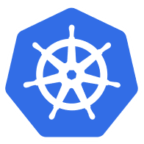

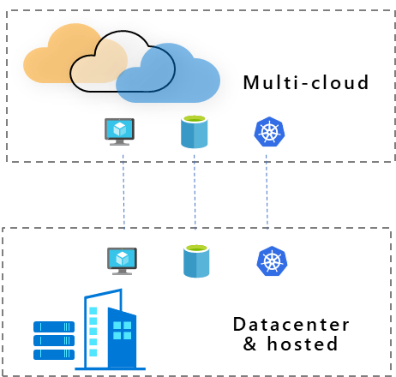

Azure Arc
Extend Azure management and services anywhere
Multi-cloud
Datacenter & hosted
Gain central visibility, operations, and compliance
Build Cloud native apps anywhere, at scale
Run Azure services anywhere
Azure is already trusted and proven by our customers. Azure Arc uses the same APIs and the same control plane as Azure, providing consistency across the hybrid infrastructure, which increases productivity and reduces risk.”
With Azure Arc, we can centrally manage multiple edge locations and help our customers grow and expand across the continent, creating more jobs and economic opportunities along the way."
For me, the main benefit is that my managers do not have to go to three different places to see the health of our database environment. I want to reinforce this over and over again because that’s what’s driving us.”
Notes:
With Azure Arc, you can benefit in 3 different scenarios. Arc helps you accelerate innovation across hybrid and multi-cloud environments with simplified management, faster app development, and consistent Azure services.
1) First, if you have workloads running outside Azure, you can centrally manage all these resources consistently in Azure, whether they are Windows, Linux, SQL Server or Kubernetes clusters. You can govern, organize, and inventory assets in a homogenous way and get central visibility to them from a single pane of glass, all from within Azure. This helps you meet governance, compliance, and organizational standards through policies for all your apps, infrastructure, and data.
2) Next, Azure Arc helps you build cloud native apps anywhere, at scale. You can leverage the modern cloud native app development practices, meaning you can use DevOps techniques to deploy and manage Kubernetes apps at scale on your choice of any certified Kubernetes distribution. You can also reduce errors with consistent configuration and policy-driven deployment and operations for applications and Kubernetes clusters. Use Arc to centrally manage and delegate access for DevOps roles and responsibilities.
3) And lastly, you can run Azure services such as Azure SQL Managed Instance and Azure PostgreSQL Hyperscale anywhere. With Azure Arc, you can implement cloud practices and automation to deploy faster, consistently, and at scale with always-up-to-date Azure Arc-enabled data services.

Slide 7



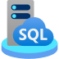





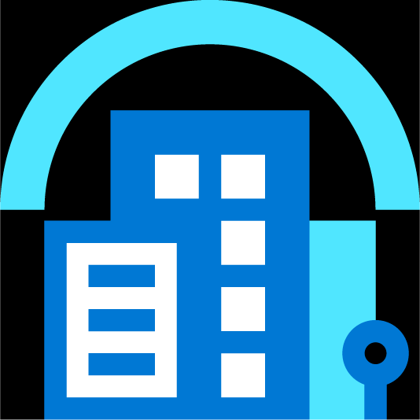
Single control plane with Azure Arc
Azure Arc-enabled infrastructure
Connect and operate hybrid resources
as native Azure resources
Azure Arc-enabled services
Deploy and run Azure services outside of Azure while still operating it from Azure
Multi-cloud
Datacenter
Edge
Notes:
So what exactly is Azure Arc and how does it work?
Azure Arc is a set of technologies that unlocks new hybrid scenarios for customers by extending Azure services and management to any infrastructure so that customers can build, operate, and manage all of their resources for traditional, cloud-native and distributed edge applications in a consistent way across the entire IT estate.
This means that you can now manage and operate all of your existing and new IT resources consistently and at-scale, wherever they reside, from Azure.
To unpack this a bit more, Azure Arc-enabled infrastructure enables you to connect your resources, which live outside of Azure today, and operate them as if they where native Azure resources, using the same management tools and services that Azure provides.
And with Azure Arc-enabled services, you have the flexibility to deploy fully managed Azure services anywhere – on-premises or in other public clouds so you can take advantage of cloud benefits everywhere, such as scalability, fast deployment, and always up-to-date cloud innovation. What’s awesome is that you can initiate and manage these deployments, right from the Azure Portal.

Slide 8


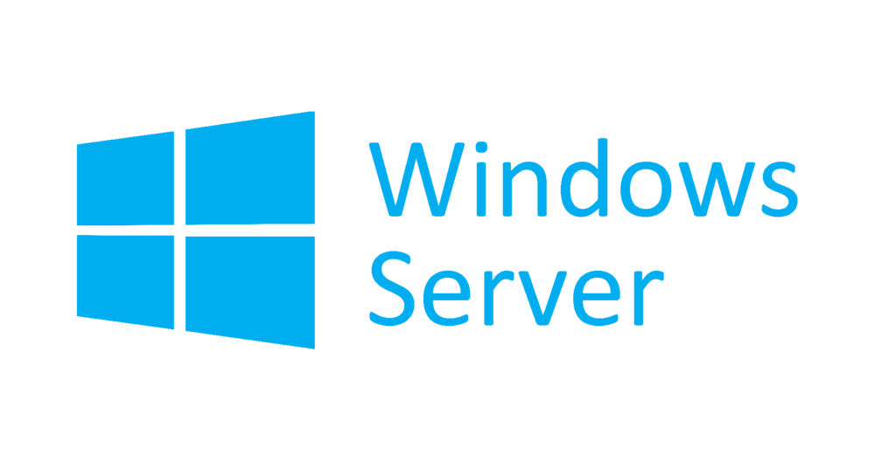







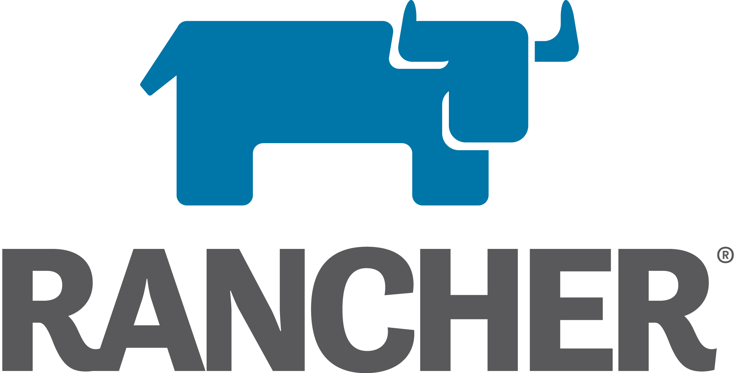


Azure Arc-enabled infrastructure Bring on-premises and multi-cloud infrastructure to Azure with Azure Arc
Azure Arc-enabled servers
Azure Arc-enabled SQL Server
Azure Arc-enabled Kubernetes
Organize, inventory, and monitor
Governance and Security
Simplified role-based operations
Physical, Virtual, Windows, Linux
Organize, inventory, and monitor
Governance and Security
Use with your existing SQL servers
SQL on Windows or Linux servers
Organize, inventory, and monitor
Governance and Security
Monitoring and Policy
GitOps-based zero-touch deploy
AKS on Azure Stack HCI
OpenShift
AWS Linux 2
GENERALLY AVAILABLE
PUBLIC PREVIEW
GENERALLY AVAILABLE
Notes:
So we talked about Azure Arc extending the Azure control plane to your existing infrastructure and we saw a real example where this scenario comes to life.
Let’s talk about what kind of Infrastructure services you can enable with Azure Arc – with GA of Azure Arc-enabled servers, we support Windows Server and a wide range of Linux operating systems such as SUSE and RedHat. On Arc-enabled SQL Server, which is in public preview, in addition to the governance and inventory benefits, you are able to take advantage of additional value such as Azure Security services or proactive SQL assessments ensuring your databases are optimally tuned.
On Arc-enabled Kubernetes, we support a wide range of distributions, again offering you that flexibility of choice without forcing you to stick to a single solution. You can use cloud native tools practices and GitOps configuration and app deployment to one or more clusters at scale. We also announced the preview of AKS on Azure Stack HCI at Ignite which lets customers deploy and manage containerized applications on Azure Stack HCI, which can be managed by Azure Arc.

Slide 9



Azure Arc-enabled servers Bring on-premises and multi-cloud servers to Azure with Azure Arc
Reach
Organize and Inventory
Governance and Security
Role-Based Operations
Linux and Windows
VM and Bare-Metal
Domain agnostic
At scale searchable inventory
Unify management experience
Consistent VM extensions
Integrate with Azure Lighthouse
Built-in Azure policies
Server security baselines
Compliance across environments
Centralized agent management – Monitoring, Security, Update Management
Central IT to manage at-scale operations
Workload owners manage based on their access
Any infrastructure, familiar tools
Notes:
So, just want to summarize Azure Arc-enabled servers for you.
You can onboard a wide variety of servers to Azure with Azure Arc – Windows, Linux, VM, Bare-Metal that are running anywhere. You can organize all these servers and apply governance across all these servers and apply role-based access control. In addition, you can also deploy Azure VM extensions to non-azure Windows and Linux VMs, simplifying the management of your hybrid machines on-premises, edge and other cloud environments. All of these capabilities are unparalleled in the market today.

Slide 10

Azure Arc-enabled servers Azure Arc-enabled servers are auto-enrolled with additional Azure services
Additional services
Azure Policy
Azure Defender
Azure Sentinel
Azure Monitor
Change and inventory tracking
Update management
Azure Security Center
AWS Linux 2
Just turn them on when you want to use them
Notes:
Remember, I talked earlier about how Azure Arc extends Azure management services to your non-Azure VMs? Well, a common question we get is : Which management services can I use with my Arc-enabled VMs. As you can see here, we have a variety of Azure management services, all of which can be applied to your Arc-enabled machines today.

Slide 11




Azure Arc-enabled SQL Server Data management benefits for Azure Arc-enabled servers
Flexibility
Management
Governance and Security
VMs and bare-metal servers
On-premises and multi-cloud
Searchable inventory
SQL Assessment service
Azure Policy
Azure Defender
No migration needed for existing SQL Servers
Notes:
Use the Azure Portal to register and track the inventory of your SQL Server instances across on-premises, edge sites, and multi-cloud in a single view.
Use Azure Security Center to produce a comprehensive report of vulnerabilities in SQL Servers and get advanced, real time security alerts for threats to SQL Servers and the OS.
Investigate threats in SQL Servers using Azure Sentinel.
Periodically assess SQL Server environment to receive actionable health guidance.
You can also govern across all your SQL Servers with built-in Azure policies to audit and secure your SQL Server estate.

Slide 12


Azure Arc-enabled servers The future of Microsoft Endpoint Configuration Manager (formerly SCCM)
The Azure management services enabled by Azure Arc can replace much of the functionality of MECM, but we recommend a gradual transition based on the use case. In some cases, MECM cannot be replaced yet.
On-Premises VMs
MECM
Azure Arc
Capabilities
Change and inventory tracking
Update/patch management
Security
Notes:
A popular question that gets asked in the context of Arc is if it is meant to replace SCCM (System Center Configuration Manager, now called Microsoft Endpoint Configuration Manager, MECM). SCCM is a popular systems management product developed by Microsoft that is predominantly used on-premises to manage Windows Servers.
The short answer to this question is ‘No’. Some of the capabilities of MECM can be achieved by different Azure management services, but not all. We recommend a gradual transition between the two based on the specific case as we’ll now see..<Click>

Slide 13
Azure Arc-enabled servers Co-management with Microsoft Endpoint Configuration Manager (MECM – formerly SCCM)
Use case | MECM | Azure management service enabled by Azure Arc
Software updates on Windows Server machines anywhere
Software updates on Linux machines anywhere
Software updates on your Windows clients (e.g., running Windows 10)
Software updates for on-premises systems which are behind an internet gateway
Server inventory and information collection
Run custom scripts on machines
MECM tracks and applies software updates to Windows Server machines in your organization
Azure Update Management uses the Log Analytics agent and can run on supported Windows Server OS for patch/update control
Azure Update Management uses the Log Analytics agent and can run on supported Linux distributions for patch/update control
N/A
MECM manages the deployment of software updates to clients in your organization
N/A
MECM can work with and configure cloud gateways. Boundary groups. Proxy etc. to manage the machines
Azure Update Management can work with the Log Analytics Gateway, to manage machines behind proxy and firewalls
MECM CMPivot can provide real time state of machines in the environment
Azure Automation Change Tracking and Inventory tracks changes in virtual machines and server infrastructure
Use Custom Script Extension in Azure or Process Automation in Azure Automaton to create and manage PowerShell scripts and workflows, Python scripts and graphical runbooks.
MECM has an integrated ability to run custom PowerShell scripts
Notes:
Use case Part 1.
Here is a quick map between the different use cases of MECM and the corresponding management service in Azure that offers the same capability. As you can see, sometimes there is a 1:1 map. For example, Azure Update Management can be used to manage software updates on Windows Server machines running anywhere, so you could potentially transition out of SCCM for this. But not everything has this 1:1 map. As mentioned, before MECM is used mainly for managing Windows Server and cannot be used to manage updates on Linux servers, Azure Update Management can be used for the same. Similarly, for managing Windows 10 clients, only MECM can help realize this use case, there is no equivalent service in Azure.

Slide 14
Azure Arc-enabled servers Co-management with Microsoft Endpoint Configuration Manager (MECM – formerly SCCM)
Use case | MECM | Azure management service enabled by Azure Arc
Create, manage and deploy applications on machines
Manage OS upgrades
Manage policies to mitigate malicious attacks and security vulnerabilities
MECM can manage deployment of applications and packages with automation built-in
Use Azure Custom Script Extension to deploy apps and packages to VMs, doesn’t have a UI like Software Center in MECM
MECM can deploy and update Windows via different methods and automate tasks
N/A
MECM manages policies for Windows Defender, Bit locker, VPN etc. to secure machines
Azure Security Center provides unified security management and advanced threat protection across hybrid cloud workloads.
Notes:
Another use case which only MECM is applicable for is Operating System Upgrades on your servers. This cannot be done today using any service in Azure. As you can see, the decision to move out of SCCM and adoption of an equivalent Azure service will depend on the use case you are looking to solve for.

Slide 15




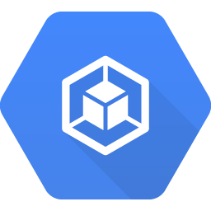

Azure Arc-enabled Kubernetes Connect, manage, and operate Kubernetes clusters and applications running anywhere using Azure Arc
Govern and Secure
Connect
Configure
Operate and Monitor
Support for multiple flavors
Deploy to an existing cluster
OSS ecosystem friendly
Configure GitOps workflows
Enforce desired state across clusters
Cluster & Namespace support
Azure Monitor Integration
Health status reporting
Cluster & App observability
Built-in Azure Policies
Cluster security baseline
Role-Based Access Control
Compliance across environments
Any infrastructure, any Kubernetes
kubeadm
AKS
OpenShift
EKS
GKE
VMware Tanzu
Notes:
So, just want to summarize Azure Arc-enabled Kubernetes for you.
Again, similar to Arc-enabled servers, we offer a lot of flexibility to you based on your specific needs. We support a wide range of Kubernetes distributions with flavors from different vendors – as you can see on the slide. You can connect all these clusters to Azure and start deploying applications to these clusters using a GitOps-based model.
Additionally, you can enable cluster health monitoring with Azure Monitor for Containers. Another powerful capability is the integration with Azure Policy that can ensure compliance with the organization’s security baselines.

Slide 16


Azure Arc-enabled Kubernetes
Easily integrate with Azure services using Cluster Extensions
PUBLIC PREVIEW
Monitor
Secure
Collect metrics and logs of application workloads
Open ecosystem
Multi-cluster roll-up and cluster
drill down views
Azure Defender Integration
Threat detection across on-premises and multi-cloud
Actionable recommendations for security best practices
Notes:
With the new Cluster Extensions feature, you get a modern management experience on your Arc-enabled Kubernetes clusters. Users can now deploy and configure services like Azure Monitor and Azure Defender via the Azure Portal, CLI and APIs. Previously, these add-ons could be only be deployed manually via Helm Charts.
Azure Monitor Container Insights
The first experience we are enabling is Azure Monitor Container Insights. Monitoring your containers is critical, especially when you're running a production cluster, at scale, with multiple applications. Azure Monitor for Containers has been available for AKS, ARO as well as self managed clusters hosted using AKS-Engine but we can now extend this easily to any Kubernetes cluster, even one running on AWS or GKE!
Container insights delivers a comprehensive monitoring experience across the full stack with workload monitoring encompassing collection of metrics and logs that are sent to Log Analytics resource in the customer’s tenant and subscription. You can get rich live telemetry on cluster health, node/pod status and container performance and correlate these metrics/logs across the App & Infra layers for full stack diagnostics. Container Insights also offers rich integration with the Open Source Ecosystem with support for metrics from Prometheus, Grafana and OpenTelemetry.
Azure Defender
Azure Defender can now be easily extended to clusters that live outside of Azure through the Azure Defender extension for Arc-enabled Kubernetes clusters. This can be easily enabled through the Azure Portal or CLI and supports multiple Kubernetes distributions across on-premises and multi-cloud. You can get a single pane of glass view in Azure to easily monitor the security posture of all your Kubernetes clusters, no matter where they are deployed and detect threats across these clusters using advanced analytics.
Once deployed, the extension collected Kubernetes data and sends it to the Azure Defender backend in the cloud for further analysis. Azure Defender continuously analyzes the Kubernetes cluster for potential threats based on collected data and reports threats and malicious activity detected as Alerts in Azure Security Center.
More new extensions for Azure Policy (Gatekeeper) and Open Service Mesh are coming soon.
Azure Arc-enabled data services will also be deployable as an extension.

Slide 17



Azure Arc-enabled Kubernetes
Provide Azure services and users secure access to Arc-enabled Kubernetes clusters
PUBLIC PREVIEW
AAD RBAC
Cluster Connect
Custom Locations
Role assignments in Azure to control authorization checks in cluster
Cluster scope and
namespace scope support
Custom roles support
No inbound ports needed on firewall
Interactive developer debugging from anywhere
Deploy using GitHub Actions and Azure DevOps Pipelines hosted agents
Deploy Azure PaaS services
to any location
Notes:
AAD RBAC: The Kubernetes native way of defining authorization checks involves creation of ClusterRoleBindings and RoleBinding objects in the cluster. The AAD RBAC feature instead allows for usage of Azure role assignments as the single source of truth for all authorization checks happening on the cluster. Any requests sent to the API server of the cluster are checked with the Azure authorization service to see if the entity making the request (user or service principal) is allowed (or not allowed) to access the resource of concern. This feature allows for a single place of audit on all the role assignments made on any resource within any of the Arc-enabled Kubernetes clusters.
Note: This feature is only applicable for those self-managed Kubernetes clusters where the apiserver of the cluster is accessible by the customer. As a result, this feature is not applicable for cloud provider managed K8s clusters like GKE and EKS. On AKS, this feature is available natively and Arc onboarding of the cluster is not required for the same.
Cluster Connect: Cluster Connect feature of Azure Arc-enabled Kubernetes provides connectivity to the apiserver of the cluster without requiring any additional inbound communication to be enabled. This is achieved by mapping a Hybrid Connections resource on the Azure service side to every Arc-enabled Kubernetes cluster where a reverse proxy agent is able to securely initiate a session with hybrid connection in an outbound manner. This feature allows your developers to access the clusters from anywhere for interactive development and debugging. If you already have a lot of investments in terms of paid pipeline concurrency for Azure Pipelines or GitHub Actions or any other hosted CI/CD provider, you can now reuse the same to deploy against even on-prem clusters without requiring self hosted agents (VMs) on-prem.
Custom Locations: In Azure, every resource is created in a specific location such as eastus or westeurope. This location maps to an Azure region. Custom location allows for extension of this concept beyond the boundaries of Azure to allow customers to define their own Kubernetes clusters (on-prem or hybrid) as targets for running Azure PaaS services. This allows for consistent developer experience across Azure and off-Azure environments.

Slide 18

Azure Arc-enabled data services
Cloud experience for data workloads anywhere
GENERALLY AVAILABLE
Azure SQL
PUBLIC PREVIEW
Azure Database for PostgreSQL
Support all connectivity modes
Always current
As-a-Service
Elastic scale
Unified
management
Any hardware, any Kubernetes

Slide 19





Common hybrid data scenarios
Extending and migrating existing apps
Building new cloud native apps
Drivers: Digital transformation, compliance, latency
Drivers: Existing investments, TCO
Cloud automation, always up-to-date for on-premises databases
“as-a-service” + cloud billing model for on-premises data workloads
Governance and asset tracking across multi-cloud
Consistent, portable databases on Kubernetes
Real-time compute and insights when data is created at the edge

Slide 20

Customer scenario Run Azure data services anywhere
Overview
A Manufacturing company wants to build new applications or modernize existing applications and infrastructure so they can capture and analyze data at remote locations worldwide and deliver onsite, real-time insights with no latency.
Customer has little to no visibility or control over on-premises or multi-cloud applications at remote locations.
Intermittent connectivity or latency issues preclude using Azure services.
Limited IT-administration resources at remote locations.
Business requirements
Leverage existing OEM hardware and any Kubernetes
Latest innovation automatically deployed from edge to cloud
Automation at scale for IT control systems e.g., HA/DR, backup, CI/CD, DevOps
Consistent security and governance
Move from a renewal cycle to an evergreen model for their data services.
Factory N
…
Factory 2
Factory 1
Streaming data from machines
Persist and Compute in Azure Arc-enabled data services
Azure SQL Edge
SQL Managed Instance
Hybrid Infrastructure
Azure Kubernetes Service

Slide 21
Customer scenario Run Azure data services anywhere
Factory N
Key benefits from Azure Arc
Leverage existing infrastructure
Build cloud-native applications on any Kubernetes.
Enjoy the cloud-like benefits of an evergreen SQL engine with no end-of-support.
Consistently manage and deploy data services across multiple locations.
Elastic scale without application downtime.
Automation at scale with unified management of all data assets, incl. SQL and OSS.
Market leading security & governance consistently deployed everywhere.
Move from a CapEx model to OpEx model with cloud billing.
…
Factory 2
Factory 1
Streaming data from machines
Persist and Compute in Azure Arc-enabled data services
Azure SQL Edge
SQL Managed Instance
Hybrid Infrastructure
Azure Kubernetes Service

Slide 22

Azure Arc-enabled Kubernetes validation program
Azure Arc
validated
Conformance testing and error resolution
Azure Arc-enabled Kubernetes validation program
CNCF certified Kubernetes distributions
Notes:
Azure Arc-enabled Kubernetes Validation Program (microsoft.com)

Slide 23



Azure Arc-enabled application services
PREVIEW
Run your apps, anywhere
App Service
Functions
Logic Apps
API Management
Event Grid
Cloud-native, at scale
Flexibility
Unified Management
Manage applications running on Kubernetes at scale with modern cloud native practices
Use the services you want with any CNCF-conformant Kubernetes cluster
Single view across hybrid and multicloud environments
Any Kubernetes, anywhere
Notes:
With Azure Arc, you can now run your favorite Azure application services anywhere, including on Kubernetes on Azure, on-premises, on the edge, and on other clouds such as AWS or Google. Any Kubernetes cluster connected through Azure Arc is now a supported deployment target for Azure’s application services.
Bdcs
Sdfs
sfds
With Azure Arc-enabled application services, developers don’t have to build and maintain custom solutions for their non-Azure environments. They can now build hybrid and multicloud applications using the portable application services powered by Azure Arc.

Slide 24
Azure Arc-enabled machine learning
PREVIEW
Build models on-premises, in multi-cloud, and at the edge with Azure Arc
Azure Machine Learning
Innovate rapidly
Operate efficiently
Unified Management
Use familiar tools
Meet regulatory compliance
Auto scale compute anywhere
Get started in minutes
No data movement
Leverage existing infrastructure
Single view for on-prem and clouds
Consistent workflows
Any Kubernetes, anywhere
Notes:
Azure Arc, now enables you to bring Machine Learning to any infrastructure across on-premises data centers, multi-cloud environments and at the edge, using Kubernetes.

Slide 25
Azure Arc pricing model
No additional cost
Control plane functionality:
Tagging, management groups, activity logs, templates, Resource Graph, RBAC
Customers’ servers and clusters
Notes:
Let’s take a look at the pricing model for Arc-enabled servers. So first, you have your own servers and clusters, you install the Arc agent on them. This basic connectivity to Azure is free of charge. In addition, we offer other control plane functionality at no additional cost – tagging, the ability to organize resources into management groups and subscriptions, RBAC and querying with Azure Resource Graph.
<One click>

Slide 26
Azure Arc pricing model
Azure Policy—guest configuration
Azure Monitor
Azure Defender
Azure Sentinel
Backup
Log Analytics
GitOps management for Kubernetes Application Insights
Config and Change Management
Additional services ($)*
Azure Arc-enabled services ($)*
SQL Managed Instance (preview, GA on 7/30)
PostgreSQL Hyperscale (preview)
Azure Machine Learning (preview)
App Service, Functions, Logic Apps, APIM, Event Grid (preview)
No additional cost
Control plane functionality:
Tagging, management groups, activity logs, templates, Resource Graph, RBAC
Customers’ servers and clusters
*Pricing for Azure Arc-enabled services and additional management services is consistent with Azure pricing.
Services are available at no cost during preview.
Notes:
So what gets charged then?
Firstly, any management service that you use with Azure
Any Azure management service, that you can see listed here, when attached to the server will be charged. The pricing model for these services will be the same as they are today for Azure VMs. For example, Azure Monitor for Arc-enabled VMs will be priced the same way as it would be for Azure VMs.
The only exceptions are Azure Policy Guest Configuration and Azure Automation services such as Update Management, DSC, Change tracking and inventory, which are free for Azure VMs but charged at $6/server/month for Azure Arc-enabled VMs. You could just use one of these or all of them together, the price remains at $6/server/month.

Slide 27
Azure Arc pricing details
 | Add-on management services | Azure Resource | Azure Arc Resource
Azure Arc control plane functionality (for both Arc-enabled servers and Kubernetes) | Onboarding, Resource organization in the Azure Portal, Tagging, Searching and Indexing, RBAC and Automation through Templates | Free | Free
Add-on management services (for both Arc-enabled servers and Kubernetes) | Azure Monitor, Azure Defender, Azure Sentinel | Refer to the pricing for the specific service in the Azure Pricing calculator | Priced similar to Azure resources. Refer to the specific service in the Azure Pricing calculator
Azure Arc-enabled servers | Azure Policy guest configuration (includes Azure Automation change tracking, inventory, state configuration) | Free | $6/Server/Month
Azure Arc-enabled Kubernetes | Kubernetes Configuration (GitOps) | N/A | First 6 vCPUs are free, $2/vCPU/month thereafter*
Azure Arc-enabled application services | App Service, Functions, Logic Apps, APIM, Event Grid | Refer to Azure pricing calculator | Free in preview. Pricing to be disclosed at GA
Azure Arc-enabled data services | SQL Managed Instance | Refer to Azure pricing calculator | Pricing varies by product tier. See next slide for details.
 | PostgreSQL Hyperscale | Refer to Azure pricing calculator | Free in preview. Pricing to be disclosed at GA
*If the Arc-enabled Kubernetes cluster is on Azure Stack Edge, AKS on Azure Stack HCI (>=April 2021 update), or AKS on Windows Server 2019 Datacenter (>=April 2021 update), then the Kubernetes configuration is included at no charge. More information on this can be found on the docs page.
Notes:
So what gets charged then?
For Arc-enabled servers: Any Azure management service, that you can see listed here, when attached to the server will be charged. The pricing model for these services will be the same as they are today for Azure VMs. For example, Azure Monitor for Arc-enabled VMs will be priced the same way as it would be for Azure VMs.
The only exceptions are Azure Policy Guest Configuration and Azure Automation services such as Update Management, DSC, Change tracking and inventory, which are free for Azure VMs but charged at $6/server/month for Azure Arc-enabled VMs. You could just use one of these or all of them together, the price remains at $6/server/month.
For Arc-enabled Kubernetes: Any number of Kubernetes clusters can be connected and organized in the Azure Portal at no additional cost. Like Arc-enabled servers, add-on Azure management services, like Kubernetes Configuration, are charged when enabled.
Kubernetes Configuration is an add-on Azure management services that deliver configuration management and application deployment using GitOps. The first 6 vCPUs are included at no cost. After that, $2/vCPU/month.
For Arc-enabled data services: In the current preview phase, Azure Arc-enabled data services is offered at no additional cost.

Slide 28
Consistent cloud billing model with Azure
General Purpose | Pay-As-You-Go | 1-year Reserved Instance | 3-year Reserved Instance
License included | $153 | $113 | $93
Azure Hybrid Benefit* | $80 | $40 | $20
Azure Arc-enabled​ SQL Managed Instance​
Pricing based on 1vCore/month. No minimum on # of vCores per instance
*Restrictions apply

Slide 29
Azure Arc-enabled servers pricing Example 1
Scenario 1: A customer onboards 50 Windows (or Linux) servers that are running on-premises to Azure with Azure Arc and tags these servers in Azure, applies RBAC, organizes these servers into management groups and queries properties with Azure Resource Graph. In addition, the customer also applies a set of common Azure Policy Guest Configurations across all these servers.
The applicable cost components are:
Component | Cost
Connectivity to Azure Arc, Tagging, RBAC, Management Groups and Azure Resource Graph | $0
Azure Policy Guest Configurations | $6/server/month (Unlimited policies)
For more details on Azure Arc pricing visit our pricing page: https://aka.ms/azurearcpricing

Slide 30
Azure Arc-enabled servers pricing Example 2
Scenario 2: A customer onboards 50 Windows (or Linux) servers that are running on-premises to Azure with Azure Arc and tags these servers in Azure, applies RBAC, organizes these servers into management groups and queries properties with Azure Resource Graph. The customer also applies a set of common Azure Policy Guest Configurations across all these servers. In addition, the customer deploys the Log Analytics agent extension to monitor the on-premises servers (Azure Monitor).
The applicable cost components are:
Component | Cost
Connectivity to Azure Arc, Tagging, RBAC, Management Groups and Azure Resource Graph | $0
Azure Policy Guest Configurations | $6/server/month (Unlimited policies)
Azure Monitor | Same Azure Monitor pricing that is applicable to Azure VMs (Refer to the Azure Monitor Pricing page to learn more)
For more details on Azure Arc pricing visit our pricing page: https://aka.ms/azurearcpricing

Slide 31
Azure Arc-enabled Kubernetes pricing Example 3
Scenario 3: A customer onboards 20 Kubernetes clusters that are running on-premises to Azure with Azure Arc and tags these clusters in Azure, applies RBAC, organizes them into management groups and queries properties with Azure Resource Graph. The customer also applies a set of GitOps configurations to deploy apps across clusters at scale. In addition, the customer deploys the Log Analytics agent extension to monitor the on-premises clusters (Azure Monitor for Containers).
The applicable cost components are:
Component | Cost
Connectivity to Azure Arc, Tagging, RBAC, Management Groups and Azure Resource Graph | $0
GitOps Configurations | $2/vCPU/month
Azure Monitor | Same Azure Monitor pricing that is applicable to Kubernetes clusters in Azure (Refer to the Azure Monitor Pricing page to learn more)
For more details on Azure Arc pricing visit our pricing page: https://aka.ms/azurearcpricing

Slide 32
Azure Arc-enabled data services Business model comparison
Traditional SQL Server
Azure Arc-enabled data services
Azure PaaS data services
Provided Capabilities
Limited Azure management services
Azure management services
Azure Monitor
Azure Backup
Security Center
Azure Policy
Azure Site Recovery
Config management
Azure management services
Database manageability
Database manageability
On-demand scaling
Patching
Automatic HA/DR
Local monitoring
Automatic Backup/Restore
Self-service (de)provision
Database manageability
Database License
Database license
Database license
MS SQL
PostgreSQL Hyperscale
Not Applicable
Azure Arc
(no cost)
Tagging, management groups, logs
Templates, Resource Graph, RBAC
Azure control plane
(no cost)
Customer provided infrastructure
Customer provided infrastructure
Azure infrastructure
Underlying infrastructure
Certifications
Not provided by MSFT
Traditional Licensing
Cloud Billing
Notes:
Notes to designer : Slides 10-12 are one click transitions, like slides 22-23 in the “Azure Arc Overview Customer Deck”

Slide 33


Azure Lighthouse
Your Practices
Multi-cloud
Datacenter
Edge
Azure Lighthouse
Azure Management
Azure Arc
Customer 1
Customer 1
Customer 2
Customer 2
Customer 3
Customer 3
Notes:
So far we learnt about Azure Lighthouse and Azure Arc. Let’s see how this can work for a service providers/partners.
As a service provider, with Lighthouse you have a precise, granular access to customers Azure environment. A customer can delegate a specific subscription or resource group to Service provider, who can manage multiples customers from their own environment.
We hired 3rd party company - Forrester to quantify the impact of Lighthouse on partners. Per Forrester, Azure Lighthouse can help a medium size partner save ~$2-3M/year in opex.
In addition, our own analysis tells us that the Azure environment that is managed by a partner through Lighthouse, grows in revenue incrementally by ~10-20% faster than normal growth.
Click.

Slide 34
Azure Lighthouse and Azure Arc Azure Arc extends Azure management, services, and Azure Lighthouse anywhere
Your Practices
Multi-cloud
Datacenter
Edge
Azure Lighthouse
Azure Management
Azure Arc
Customer 1
Customer 1
Customer 2
Customer 2
Customer 3
Customer 3
Windows Server | Linux | Kubernetes | SQL | Azure data services
Notes:
Now, through Arc, similar capabilities and benefits can also be applied to customers' environments that are everywhere. These hybrid management capabilities can provide partners generate even additional operational savings and growth opportunities.

Slide 35
Azure Lighthouse and Azure Arc New opportunities for partners
Expand your revenue opportunities
Improve operational efficiency
Overcome common customer objections
Manage servers anywhere
Manage Kubernetes anywhere
Build hybrid cloud native apps
Resell and use Azure services
Standardize DC operations
Consistent tooling
Simplify and automate governance
Enforce security
Ensure compliance
Address latency
Develop visibility
Provide control
Azure | AWS | GCP | Kubernetes | Windows | Linux | Data

Slide 36



Enhance offerings with Azure Arc
Run Azure services anywhere
4
Integrate into automations & dashboards
3
Governance & security at scale
2
Global inventory, tagging, automation, & search
1
Existing tools
Customer resources
Notes:
Single agent install for over XXX number of Azure management and security services
Apply Azure governance and security, at scale, with no custom development
Automate ARM calls into your existing automations and dashboards

Slide 37


Example: Azure Arc Partner Opportunity – Migration
Scenario: A customer has 100 VMs (Linux/Windows) running on-premises. The VMs consist of file servers, SQL instances, web servers and backend servers. You as a partner have been brought in to conduct an analysis of the infrastructure, execute the migration and implement a unified operations strategy using Azure native tools.
Azure Policy
Guest Config Policy+ Sentinel ACR $
50 x Azure Arc enabled Servers
Migration
50 x Azure VMs + Sentinel
50 x On-Premises VMs
50 x Azure VMs
50 x Azure Arc enabled Servers + Sentinel
100 x On-Premises VMs
ACR $ generated
from the migration
+
Sentinel ACR $
Notes:
We are starting with 100 on-premises virtual machines, generating 0$ ACR
By migrating 50 of these VMs to Azure, we are generating ACR only for these 50 VMs but “leaving money on the table” for the other 50 on-premises VMs who “stayed behind”
We are now enabling Azure Sentinel for the 50 Azure VMs which generates more Azure ACR but we are still not generating ANY ACR for the “stayed behind” on-premises VMs
Now, by onboarding the 50 on-premises VMs into Azure Arc, which does not have a cost, we are making progress towards generating ACR for the on-premises VMs
By applying Azure Policy, which will enforce Azure Sentinel on all 50 on-premises Azure Arc enabled servers, we are now generating 6$ per Azure Arc enabled server via Azure policy as well as ACR $ coming from Azure Sentinel This means we are maximizing the ACR opportunity and no longer leaving money on the table!
This example shows the potential of “unlocking” an Azure service such as Sentinel for on-premises assets which without Azure Arc, would have not generate any ACR,
Like Azure Sentinel, other Azure services can be unlocked using Azure Arc. Services such as (but not limited to) Azure Security Center, Azure Monitor, Azure Log Analytics, etc. can now all be applied and utilized by Azure Arc enabled servers.

Slide 38




Example: Azure Arc Partner Opportunity – Migration
Scenario: A customer has 100 VMs (Linux/Windows) running on-premises. The VMs consist of file servers, SQL instances, web servers and backend servers. You as a partner have been brought in to conduct an analysis of the infrastructure, execute the migration and implement a unified operations strategy using Azure native tools.
Azure Policy
Guest Config Policy+ Sentinel ACR $
50 x Azure Arc enabled Servers + Azure Services
Migration
50 x Azure VMs + Sentinel
ACR $ generated
From the migration
+
Sentinel ACR $
Notes:
This example shows the potential of “unlocking” an Azure service such as Sentinel for on-premises assets which without Azure Arc, would have not generate any ACR,
Like Azure Sentinel, other Azure services can be unlocked using Azure Arc. Services such as (but not limited to) Azure Security Center, Azure Monitor, Azure Log Analytics, etc. can now all be applied and utilized by Azure Arc enabled servers.

Slide 39

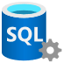
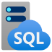

Example: Azure Arc Partner Opportunity – Data migration
Scenario: A customer has 100 SQL Server Instances running on-premises. You as a partner have been brought in to conduct an analysis of the data estate, execute a migration to Azure and implement a hybrid approach using Azure native services via Azure Arc.
50 x Azure Arc-enabled SQL MI
50 x On-Premises SQL Server
100 x On-Premises SQL Servers
50 x Azure SQL MIs
$696/instance/month
$320/Azure Arc-enabled SQL MI/month
Total ADS: $609,600/year ($417,600 from Azure SQL and $192,000 from Azure Arc-enabled SQL MI)
Assumptions: General Purpose, 1-year RI on Azure Hybrid Benefit, 8 cores/instance.
Price per core/month: $40 for Azure Arc-enabled SQL MI and $87 for Azure SQL MI
Notes:
We are starting with 100 on-premises SQL DB instances, generating 0$ ACR
By migrating 50 of these SQL instances to Azure, we are generating ACR only for these 50 instances but “leaving money on the table” for the other 50 on-premises SQL instances who “stayed behind”
Migrating to Azure using SQL DB Managed Instance generates new Azure ACR but we’re still not generating ANY ACR for the SQL instances that “stayed behind” on-prem
Now, by onboarding the 50 on-premises SQL instances into Azure Arc, which does not have a cost, we are making progress towards generating ACR for the on-premises instances
By applying SQL DB MI functionality to all 50 on-premises Azure Arc-enabled SQL server instances, we are now generating X$ per Azure Arc-enabled SQL server instance This means we are maximizing the ACR opportunity and no longer leaving money on the table!
This example shows the potential of “unlocking” an Azure service such as SQL DB Managed Instance for on-premises assets which without Azure Arc, would have not generate any ACR,
Like Azure Sentinel, other Azure services can be unlocked using Azure Arc. Services such as (but not limited to) Azure Security Center, Azure Monitor, Azure Log Analytics, etc. can now all be applied and utilized by Azure Arc-enabled servers.
Azure SQL MI based on 8 cores and AHB 9s $1277.13/mon x 50 = $63,856.50
Azure Arc-enabled SQL MI based on 8 cores is $320/mon x 50 = $16,000

Slide 40
Example: Azure Arc Partner Opportunity – New data workload
Scenario: A customer needs net new 100 SQL instance running across hybrid. You as a partner have been brought in to conduct an analysis of the data estate, execute a cloud-native approach to implement a unified data management using Azure native tools.
50 x Azure Arc-enabled SQL MI
100 x On-Premises SQL Servers
50 x Azure SQL MIs
50 x On-Premises SQL Server
$1,280/Instance/month
$904/Azure Arc-enabled SQL MI/month
Total ADS: $1.31 M/year ($768,000 from Azure SQL and $542,400 from Azure Arc-enabled SQL MI)
Assumptions: General Purpose, 1-year RI on License included, 8 cores/instance. (Could be AHB if extra SQL license avail)
Price per core/month: $113 for Azure Arc-enabled SQL MI and $160 for Azure SQL MI
Notes:
We are starting with 100 on-premises SQL DB instances, generating 0$ ACR
By migrating 50 of these SQL instances to Azure, we are generating ACR only for these 50 instances but “leaving money on the table” for the other 50 on-premises SQL instances who “stayed behind”
Migrating to Azure using SQL DB Managed Instance generates new Azure ACR but we’re still not generating ANY ACR for the SQL instances that “stayed behind” on-prem
Now, by onboarding the 50 on-premises SQL instances into Azure Arc, which does not have a cost, we are making progress towards generating ACR for the on-premises instances
By applying SQL DB MI functionality to all 50 on-premises Azure Arc-enabled SQL server instances, we are now generating X$ per Azure Arc-enabled SQL server instance This means we are maximizing the ACR opportunity and no longer leaving money on the table!
This example shows the potential of “unlocking” an Azure service such as SQL DB Managed Instance for on-premises assets which without Azure Arc, would have not generate any ACR,
Like Azure Sentinel, other Azure services can be unlocked using Azure Arc. Services such as (but not limited to) Azure Security Center, Azure Monitor, Azure Log Analytics, etc. can now all be applied and utilized by Azure Arc-enabled servers.
Azure SQL MI based on 8 cores and AHB 9s $1277.13/mon x 50 = $63,856.50
Azure Arc-enabled SQL MI based on 8 cores is $320/mon x 50 = $16,000

Slide 41




Example: Azure Arc Partner Opportunity – App modernization, governance and compliance at-scale
Scenario: A customer has Kubernetes-based practice in both Azure and on-premises and is struggling with infrastructure sprawl and lack of operational consistency. You as a partner have been brought in to conduct an analysis of the infrastructure and the Kubernetes practice, and implement a unified operations strategy using Azure native tools.
Azure Policy
0$ ACR
Existing customer
DevOps practices
Azure Monitor
Azure Log Analytics
Azure Defender
Azure Sentinel
Azure Management & Operations practice
DevOps practice
Existing customer management and operations practices
Application modernization with containers
Customer applications
Customer CI/CD
Pipeline Management
No visibility, no unified operations practices
Role-based access control
with Azure Active Directory
No at-scale Kubernetes infrastructure governance
On-premises/other clouds
Kubernetes clusters
Azure Kubernetes Service

Slide 42





Example: Azure Arc Partner Opportunity – App modernization, governance and compliance at-scale
Scenario: A customer has Kubernetes-based practice in both Azure and on-premises and is struggling with infrastructure sprawl and lack of operational consistency. You as a partner have been brought in to conduct an analysis of the infrastructure and the Kubernetes practice, and implement a unified operations strategy using Azure native tools.
Azure Policy
Azure Templates
Azure Audit
Azure Tags
Azure
Resource Graph
Azure Monitor
Azure Log Analytics
Azure Defender
Azure Sentinel
RBAC
GitOps
Configurations
Hybrid application modernization unified operations, DevOps, governance, compliance and security at-scale
Customer applications
Customer applications
On-premises/other clouds
Azure Arc enabled Kubernetes clusters
Azure Kubernetes Service

Slide 43
Example: Azure Arc Partner Opportunity – App modernization, governance and compliance at-scale
Scenario: A customer has Kubernetes-based practice in both Azure and on-premises and is struggling with infrastructure sprawl and lack of operational consistency. You as a partner have been brought in to conduct an analysis of the infrastructure and the Kubernetes practice, and implement a unified operations strategy using Azure native tools.
Azure Arc enabled Kubernetes ACR $ + attached services ACR $
Azure Policy
Azure Templates
Azure Audit
Azure Tags
Azure
Resource Graph
No at-scale Kubernetes infrastructure governance
No visibility, no unified operations practices
Azure Monitor
Azure Log Analytics
Azure Defender
Azure Sentinel
RBAC
GitOps
Configurations
Hybrid application modernization unified operations, DevOps, governance, compliance and security at-scale
Customer applications
Customer applications
On-premises/other clouds
Azure Arc enabled Kubernetes clusters
Azure Kubernetes Service

Slide 44
Unified Operations for Hybrid Cloud – Partner Solution types
Solution | Description | Consumption Drivers and Profit Opportunity
Inventory, Change Tracking, Update Management | Track and manage my current and future server inventory from a single pane of glass. Track changes, automatically apply updates and patches Ingest logs from servers and services Query across all my IT assets from a single tool. Automation and policy to apply these at scale to any existing or new server asset regardless of where that server is hosted (on-premises, public cloud, etc). | Log Analytics Azure Automation runbooks/watchers Azure Policy Configuration Management Azure Networking (VPN, ExpressRoute, peering, etc.) Managed Services & Consulting
Hybrid Cloud Security | I need to manage security and incident management across my public cloud and datacenter assets through policy enforcement and automation. I need to be able to do this using the Azure tools I am already familiar with for managing Azure resources such as Azure Security Center, RBAC, Azure activity log for auditing actions, Azure Sentinel for incident management and response. | All of the above PLUS Azure Security Center Azure Sentinel
Multi-customer/Multi-tenant Managed Service | As a managed service provider (MSP), I need to do all of the above stories at scale across multiple customer environments that include Azure AD tenants/subscriptions, public cloud resources, and datacenter assets. I will use Azure Lighthouse for secure delegated management and enforcement of hybrid cloud policies, security, and automation in any environment (public cloud, datacenter). | All of the above multiplied at scale with Azure Lighthouse
Notes:
These are progressive solutions. A partner can start by developing the first and expanding to the next, driving more consumption

Slide 45
Arc enabled Kubernetes – Partner Solution types
Solution | Description
GitOps for Application Consistency | As a DevOps/SRE engineer, I would like for all of my applications in our existing and future production Kubernetes clusters, hosted in multiple cloud providers as well as on-premises to be deployed with same version with no configuration drift across clusters.
GitOps for Cluster Configurations Consistency | As an IT Pro/DevOps/SRE engineer, I would like for all of our existing and future production Kubernetes clusters, hosted in multiple cloud providers as well as on-premises to be deployed with same configurations and management components such as our Ingress Controllers, Service Mesh topology, security apps, monitoring, etc.
Cluster and Container Monitoring | As an IT Pro/DevOps/SRE engineer, I need to have health visibility in single pane of glass fashion to all of my existing and future Kubernetes clusters as well as the application deployed in it, hosted in multiple cloud providers and on-premises.
Cross Platform K8s Compliance | As an IT Pro/DevOps/SRE engineer, I need visibility to see what the compliance of my clusters is across platforms as well as application configurations within the clusters
Notes:
Assessments / ‘In-a-Day’ Workshop / What the Hack (skilling and pre-sales)
Azure Arc enabled Servers (Unified Operations)
Inventory, Change Tracking, Update Management
Security and Azure Sentinel (SIEM)
MSP/Multi-customer
Azure Arc enabled Kubernetes (Cloud Native Apps anywhere)
Application Consistency with GitOps
Cluster Management with GitOps
Cluster/Container Monitoring
Milestone 1: Identify Solution to build
Assessment / Workshop
Azure Arc enabled Kubernetes (Cloud Native Apps anywhere)
Application Consistency with GitOps
Cluster Management with GitOps
Cluster/Container Monitoring
Milestone 2: Technical Skilling
Get hands on with Jumpstart/WTH
Get certified (if needed)
Milestone 3: POC/Pilot
Design reference architecture
Build Bill of Materials
Build Cost model
Build POC around solution with first customer

Slide 46
Azure Arc Partner Solution Journey
Line-up Microsoft
Internal Sync on Azure Arc Solution goals and Microsoft Commitment
Line-up Partner
Partner sync to discuss program milestones, timelines, and resource commitment
Technical Workstream
assessment, training and technical BoM build-out
Business Workstream
Publish offering, OCP GTM plan, solution BoM and program alignment
Program Launch
Presales training, customer opportunities support from Microsoft CSA and product group
Grow & Ongoing Development
Business & Technical tracking, solution optimization, case studies, wins and pipeline development

Slide 47
Technical Milestones
Milestone 1: Identify Solution to build
Migration
Cloud and infrastructure management
Governance, compliance, and security
Milestone 2: Technical Skilling
Get hands on with Jumpstart/Office-Hours
Get certified (Adv Spec - Hybrid)
Milestone 3: POC/Pilot
Design reference architecture
Best practices
Build POC around solution with first customer
Build Bill of Materials
Build Cost model
Accountability (Partner) | Person
Product Owner
Architects
Executive Sponsor
Accountability (Microsoft) | Person
Technical Enablement (CSA)
Technical Strategy (PTS)
Notes:
Assessments / ‘In-a-Day’ Workshop / What the Hack (skilling and pre-sales)
Azure Arc enabled Servers (Unified Operations)
Inventory, Change Tracking, Update Management
Security and Azure Sentinel (SIEM)
MSP/Multi-customer
Azure Arc enabled Kubernetes (Cloud Native Apps anywhere)
Application Consistency with GitOps
Cluster Management with GitOps
Cluster/Container Monitoring
Milestone 1: Identify Solution to build
Assessment / Workshop
Azure Arc enabled Kubernetes (Cloud Native Apps anywhere)
Application Consistency with GitOps
Cluster Management with GitOps
Cluster/Container Monitoring
Milestone 2: Technical Skilling
Get hands on with Jumpstart/WTH
Get certified (if needed)
Milestone 3: POC/Pilot
Design reference architecture
Build Bill of Materials
Build Cost model
Build POC around solution with first customer

Slide 48
Co-Sell Milestones
Milestone 1: Prepare Co-sell Solution
Create Co-sell Prioritized Solution
Create Sales/Marketing Assets
Pitch Deck, One Pager, Landing Page
Identify first customers (aka pipeline)
Milestone 2: Publish Co-Sell Ready Solution
Get Technically Validated
Pass review and get to Cosell prioritized
Bring to Microsoft Field (MSUS)
STU/CSU Community via ECMs
Accountability (Partner) | Person
OCP GTM
Solution Sales/Marketing Assets
Technical Architecture
Accountability (Microsoft) | Person
OCP GTM (PDM)
Lead PTS
Lead CSA
Technical Skills (CSA)
Solution Validation (CSA)

Slide 49
Rhythm of Business
Teams teams: Channel to communicate
All up weekly check in
Weekly/daily standup for building PoC
Weekly standup for building solution sales assets and meeting Cosell requirements

Slide 50
Azure Arc roadmap
Today
H2 CY21
General availability
Azure Arc-enabled servers
Azure Arc-enabled Kubernetes
AKS on Azure Stack HCI
Public preview
Azure Arc-enabled SQL Server
Azure Arc –enabled data services
Azure SQL Managed Instance
Azure PostgreSQL Hyperscale
Azure Arc-enabled ML (Training)
Azure Arc-enabled app services
App Service, Functions, Logic Apps, APIM, Event Grid
General availability
Azure Arc-enabled data services
Azure SQL Managed Instance
Azure PostgreSQL Hyperscale
Azure Arc-enabled SQL Server
Public preview
Azure Arc-enabled Azure Stack HCI
Azure Arc-enabled VMware
Azure Arc-enabled SCVMM
Azure Arc-enabled ML (Inferencing)
Kubernetes Cluster Lifecycle Mgmt.
AKS on HCI
OpenShift
VMware Tanzu/TKG
Azure Arc infrastructure & services
General availability
Server: Guest Config policy, Azure Update Management, Sentinel, Defender, Monitor, ...
Kubernetes Config Mgmt.
Public preview
Azure Monitor for Containers
Azure Defender for Kubernetes
Azure Policy for Kubernetes
Management
Services
NDA ONLY!

Slide 51






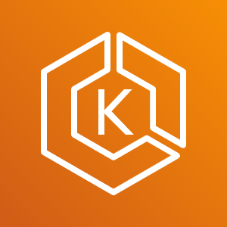


Contoso MSP Tenant Powered by Azure Lighthouse
Access Management
Portal & Dashboarding
Policy & Governance
Monitoring
Logging & Analytics
Cost Management
Security
Patch Management
BC/DR
MSP 3rd Party
Solutions Integration
Service Health
& Support
Fabrikam Azure Tenant
Parnell Aerospace Azure Tenant
App Services
Fourth Coffee Azure Tenant
Virtual Machines
Storage
Network
Kubernetes
Service
Data
Services
Cosmos DB
Functions
Parnell Aerospace
On-Premises Datacenter
Parnell Aerospace
Multi-Cloud Workloads
Azure Arc Enabled
Fourth Coffee
On-Premises Datacenter
Fourth Coffee
Multi-Cloud Workloads
Azure Arc
Azure Arc
SQL
Azure Arc
SQL Managed
Instance
Azure Arc
PostgreSQL
Hyperscale
Azure Arc
SQL
Azure Arc
SQL Managed
Instance
Azure Arc
PostgreSQL
Hyperscale
Bare-Metal
Servers
Windows & Linux
Servers
Kubernetes
Bare-Metal / VM
AWS
EC2
Elastic
Kubernetes
Service (EKS)
GCP
Instance
Google
Kubernetes
Engine (GKE)
Azure Arc Kubernetes Data Controller
Azure Arc Kubernetes Data Controller
Fabrikam On-Premises Datacenter
Fabrikam Multi-Cloud Workloads

Slide 52

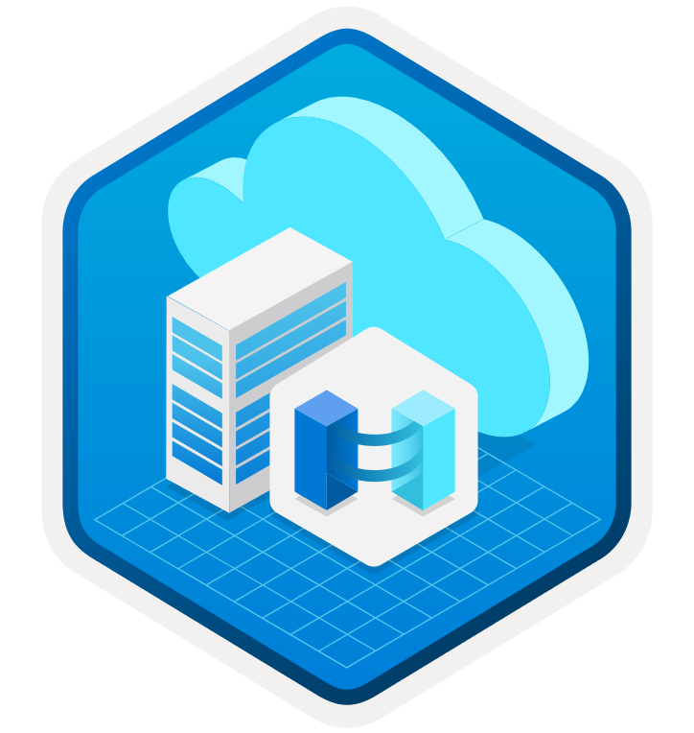
Training and resources
Azure Arc scenario-based automations & docs
Microsoft Learn Azure Arc
learning modules
Azure Arc
Tech Community
Complete guidance for hybrid and multi-cloud approach
with Microsoft Cloud Adoption Framework for Azure

Slide 53
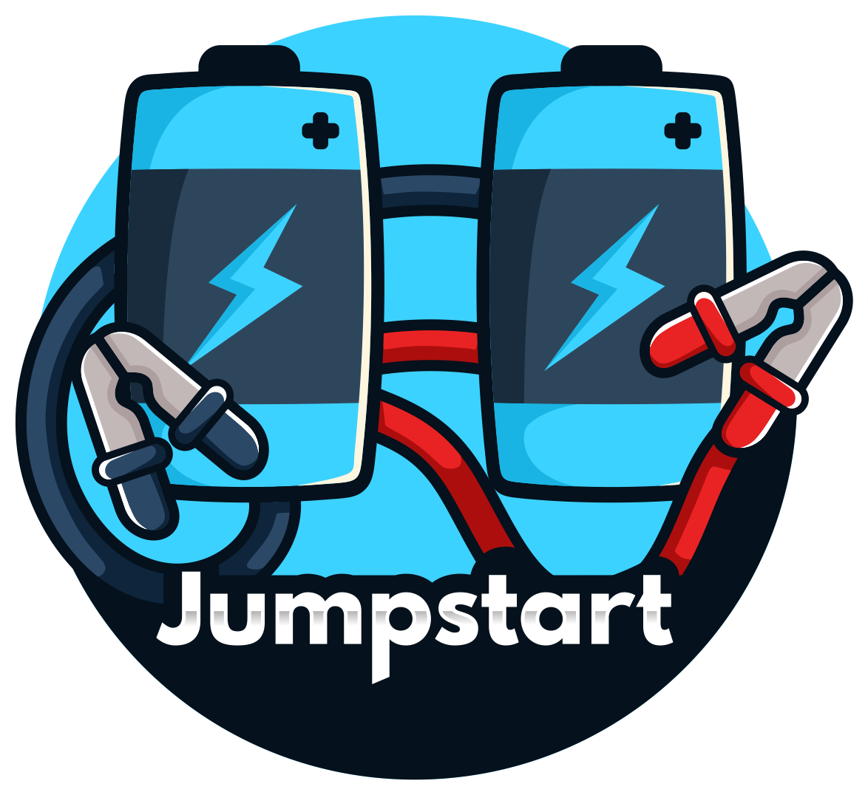
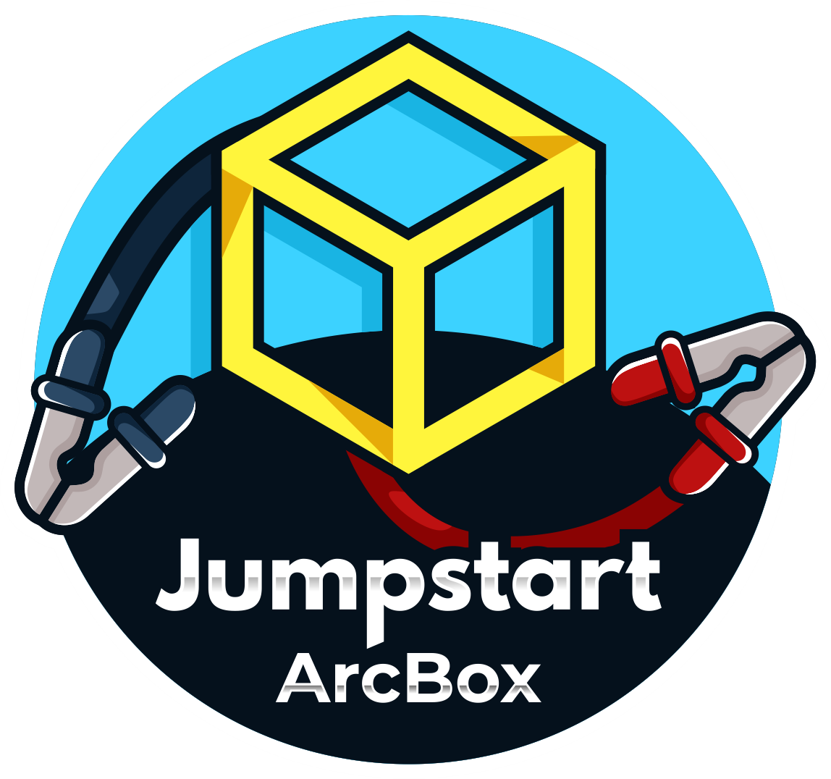

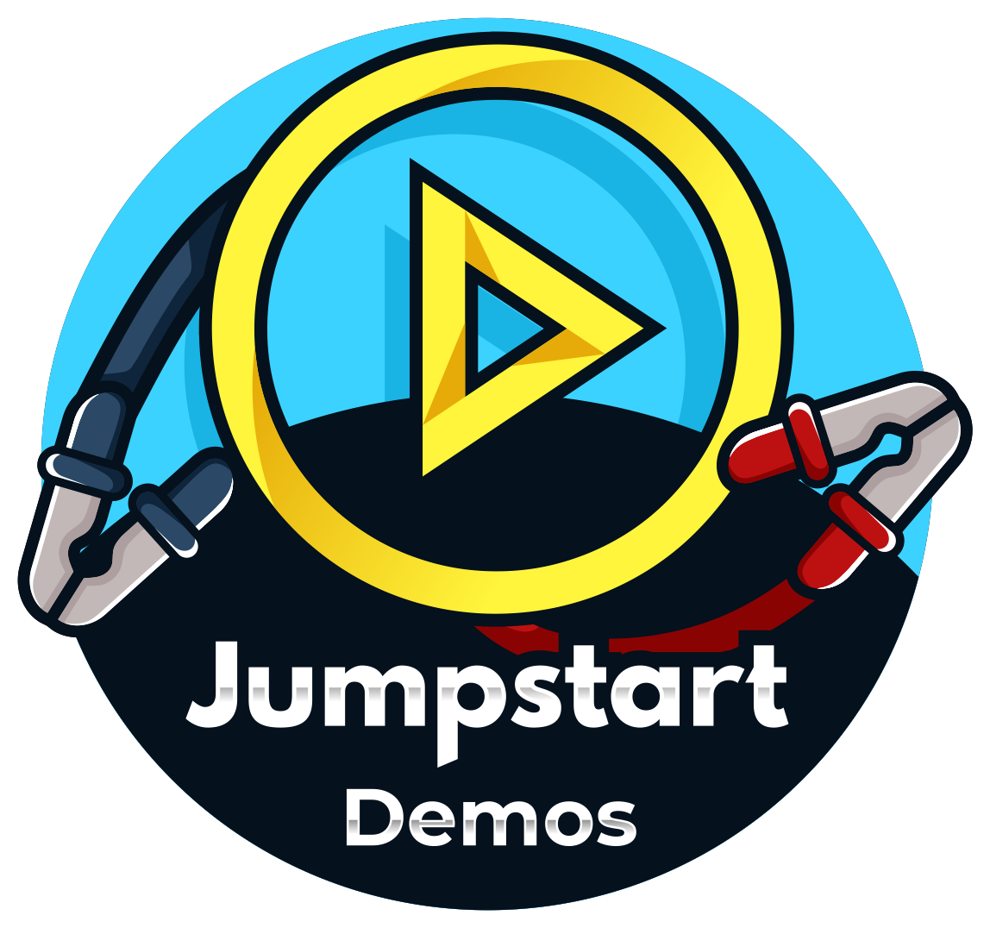
The Azure Arc Jumpstart project
Provide a “zero to hero” scenarios for multiple environments and deployment type using as much automation as possible.
Create a ”supermarket” experience by being able to take “off the shelf” scenarios and implement it.
Meeting Azure Arc customers and partners where they are.
Agile, “startup-like” team.
No detail is too small.
Ready to go technical demos
Jumpstart ArcBox is a sandbox environment that allows users to explore all the major capabilities of Azure Arc in a click of a button.
Jumpstart Lighting is a show where people come to share their Azure Arc/Jumpstart/Hybrid experience.

Slide 54
Resources
Azure Arc complete overview
Azure Arc-enabled
Kubernetes & servers
Azure Arc-enabled data services
aka.ms/arc-introvideo
Introducing Azure Arc
aka.ms/arc-compete
Azure Arc compete deck
aka.ms/azurearcpricing Azure Arc pricing page
aka.ms/arc-techcommunity
Deep dives on Azure Arc, best practices and more
aka.ms/arc-customerstories
Learn how customers are implementing Azure Arc
https://aka.ms/arc-feedback
Public Q&A forum
aka.ms/AzureArcJumpstart
Azure Arc Jumpstart
aka.ms/AzureArcJumpstartDemos
Azure Arc Jumpstart demos
aka.ms/arc-blog Azure Arc: Extending Azure management to any infrastructure
aka.ms/arc-k8svideo
Kubernetes—Managing K8 clusters outside of Azure with Azure Arc
aka.ms/arc-serversvideo
Server management—Organize all your servers outside of Azure with Azure Arc
aka.ms/arc-serversdocs
Documentation for Azure Arc enabled servers
aka.ms/arc-k8sdocs
Documentation for Azure Arc enabled Kubernetes
aka.ms/arc-datablog
Run Azure data services on-premises, at the edge, and multi-cloud with Azure Arc
aka.ms/arc-data-mechanicsvideo
Azure Arc-enabled data services demos including SQL and PostgreSQL Hyperscale
aka.ms/arc-ignite-video
Ignite 2021: Innovate across hybrid and multicloud with Azure Arc
aka.ms/arc-datadocs
Documentation for Azure Arc-enabled data services

